Slide 1

Securing Your Class or Meeting

Slide 2
Agenda
Demonstration: shut down disruptive behavior
Annotation over a shared screen
Offensive chat messages
Loud, obnoxious audio
Inappropriate webcam video
Behaviors you can prevent with Zoom profile settings
Demonstration: access and configure Zoom profile settings

Slide 3
Offensive behaviors can be displayed in …
Annotation over shared screen
Chat messages
Loud, obnoxious audio
Webcam video
Profile pictures
Inappropriate screen names
Remote control requests
Virtual backgrounds
Video filters
Notes:
B&D: Make sure your profile pic is “bad”

Slide 4
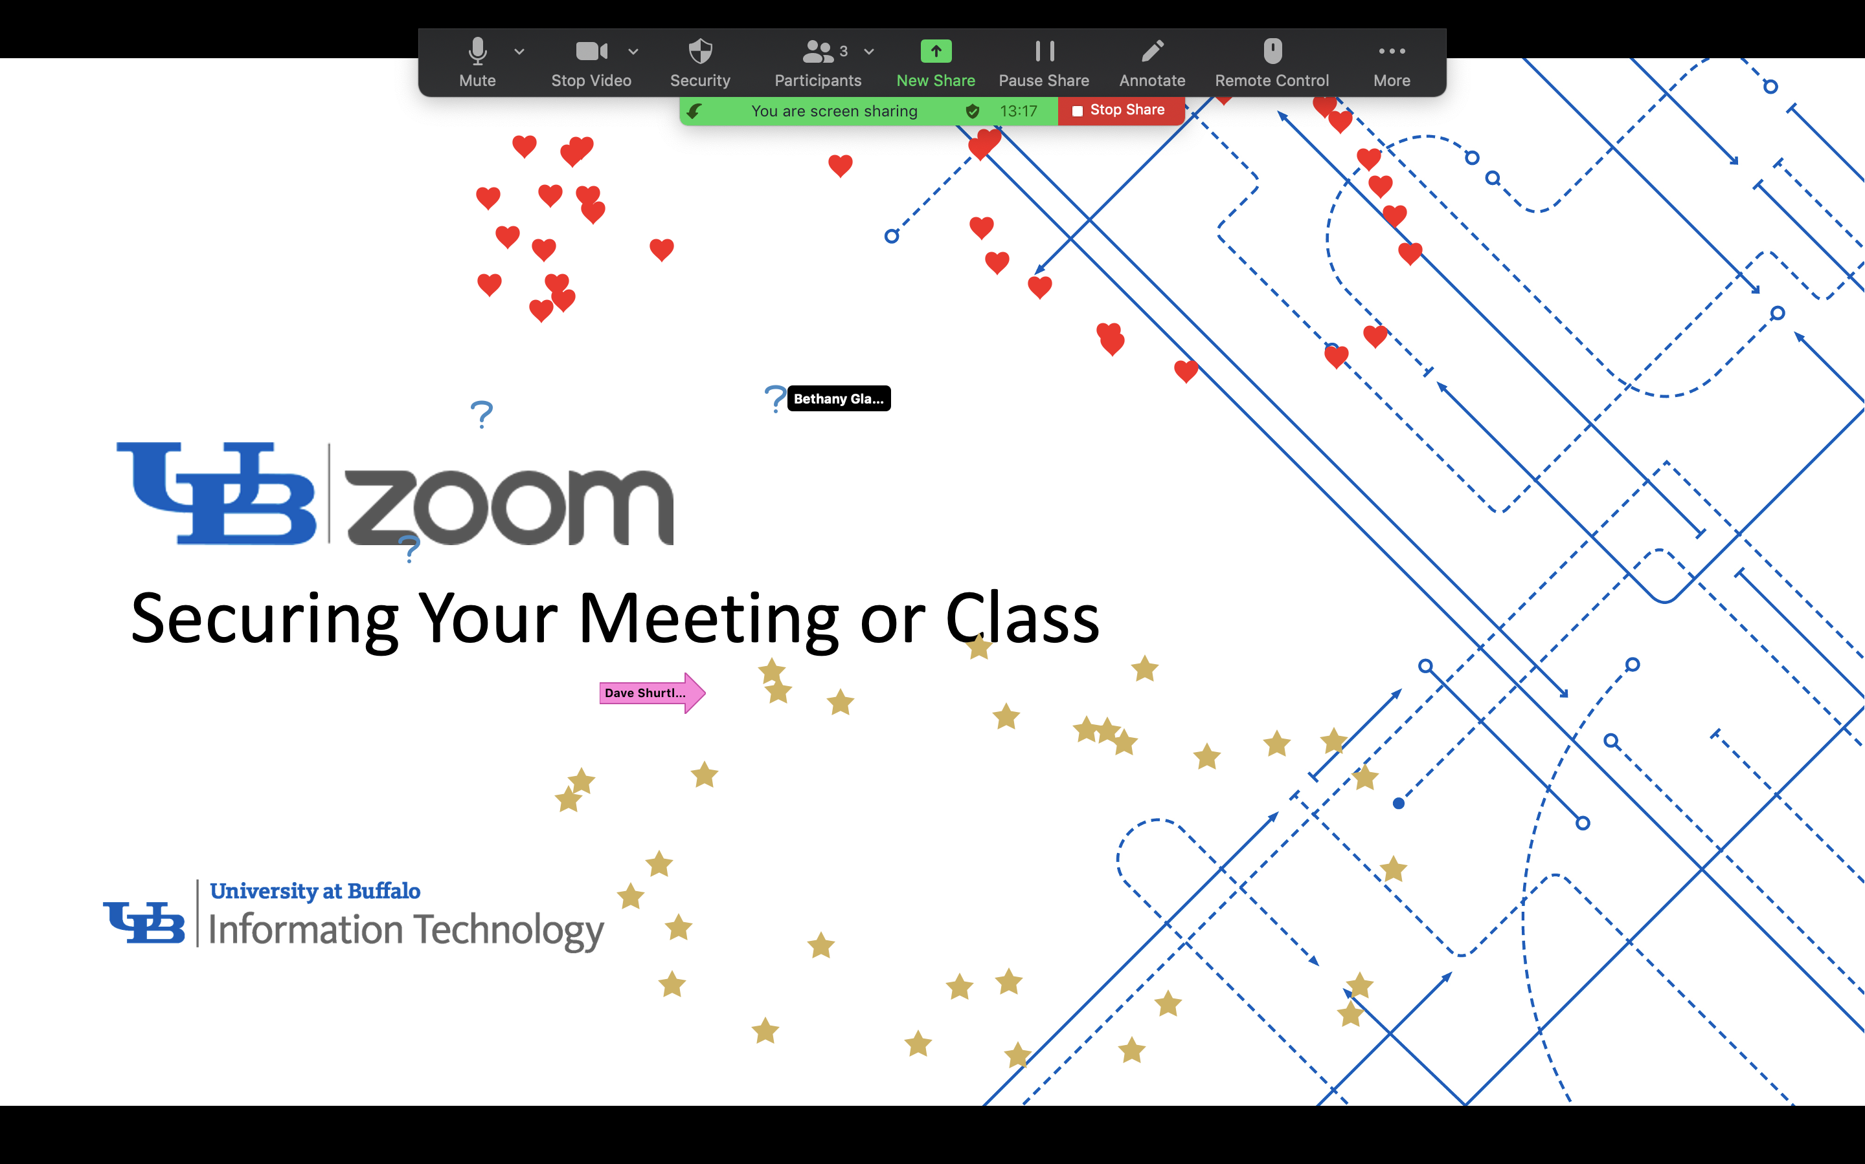
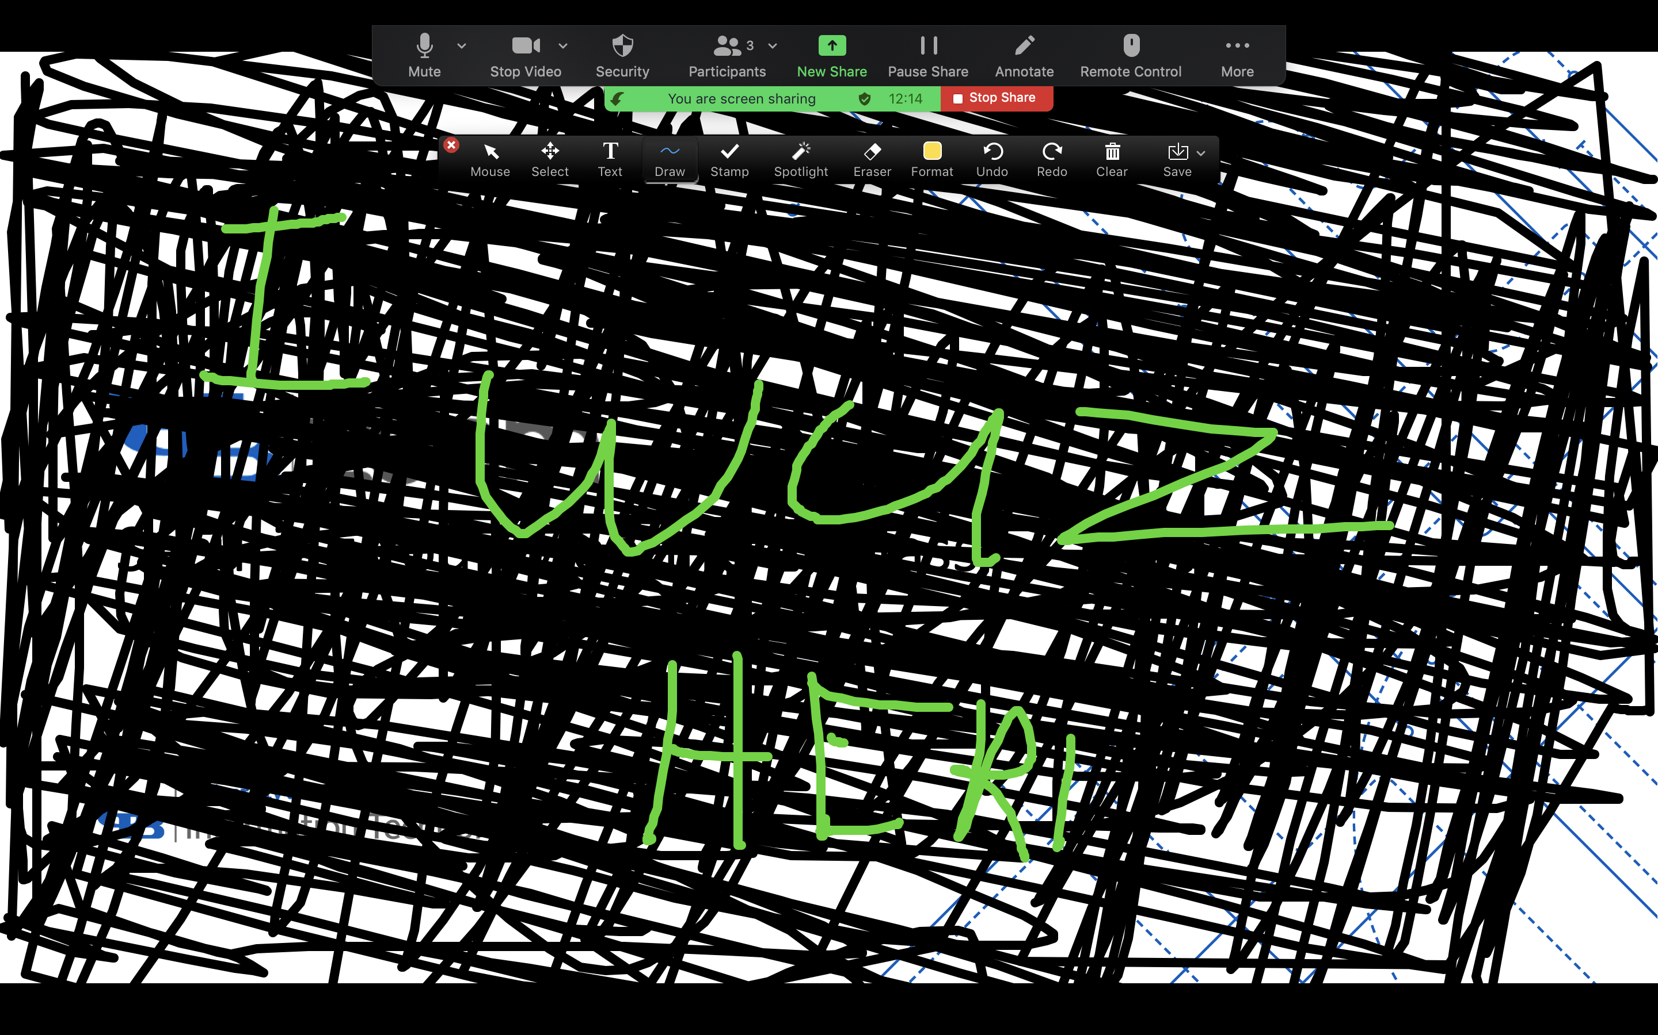
Annotating over a shared screen

Slide 5
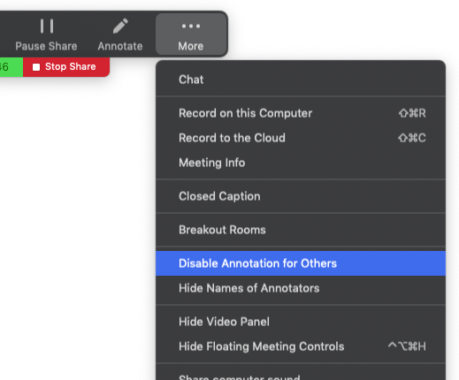
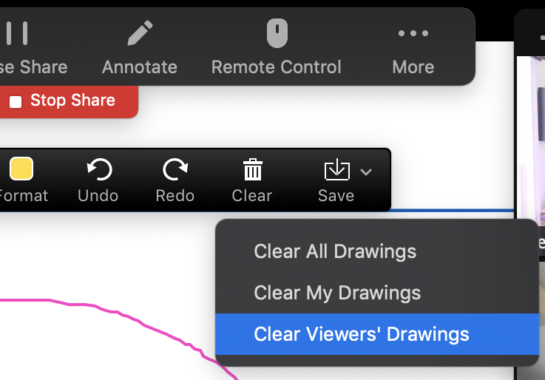
Annotating over a shared screen

Slide 6
Annotating over a shared screen
Demo
Disable annotation for others
Clear Viewer Drawings
Notes:
D&B: Annotate over this slide!

Slide 7
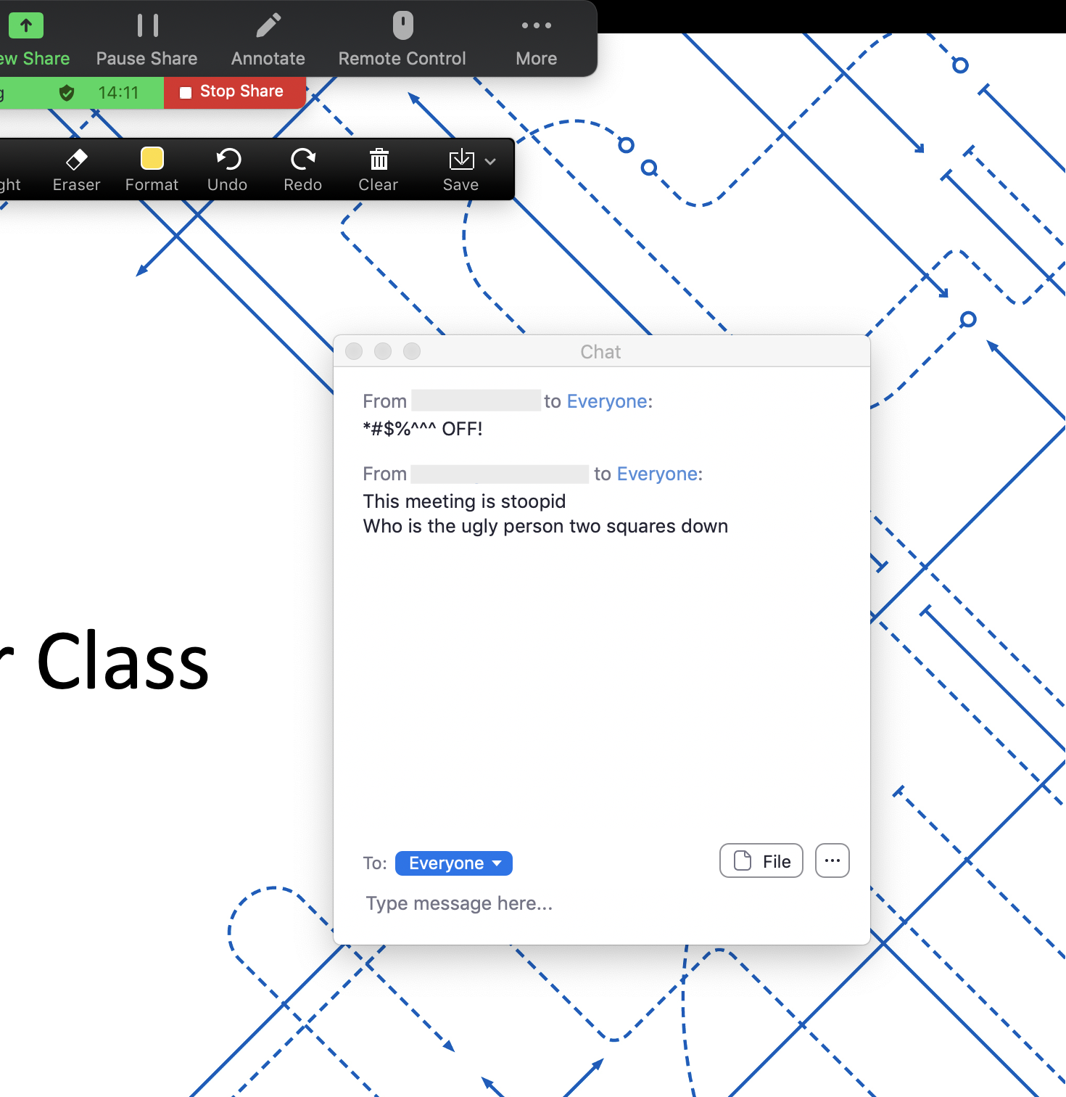
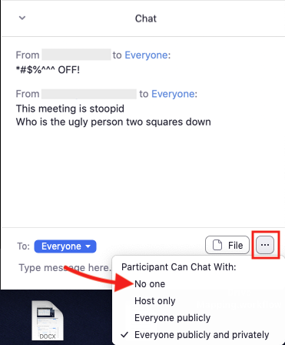
Offensive Chat Messages
Turn off chat for participants!
Notes:
B&D: Begin sending offensive chats if you haven’t already

Slide 8
Demo
Offensive Chat Messages
Turn off chat for participants

Slide 9
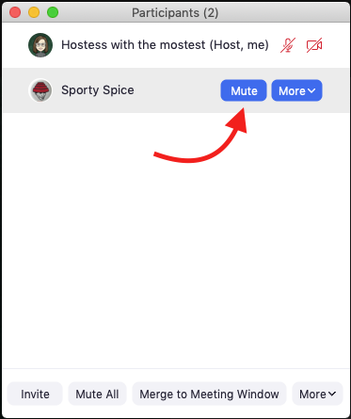
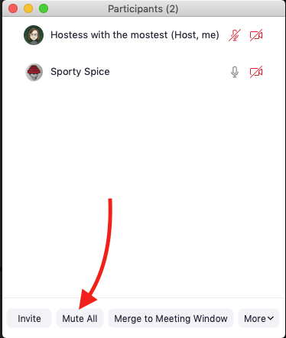

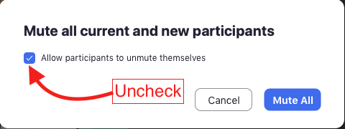
Loud, obnoxious audio
Mute one individual
Mute all participants
1
2
Notes:
This can take the form of people talking over the presenter, or playing music, or making noise. BF: RE-ENABLE CHAT

Slide 10

Demo
Loud, obnoxious audio
Open the Participants panel
Mute a single obnoxious interloper
Mute All to crush the invasion
Notes:
Dave: Sound the air horn!
Bethany: Say ridiculous things!

Slide 11
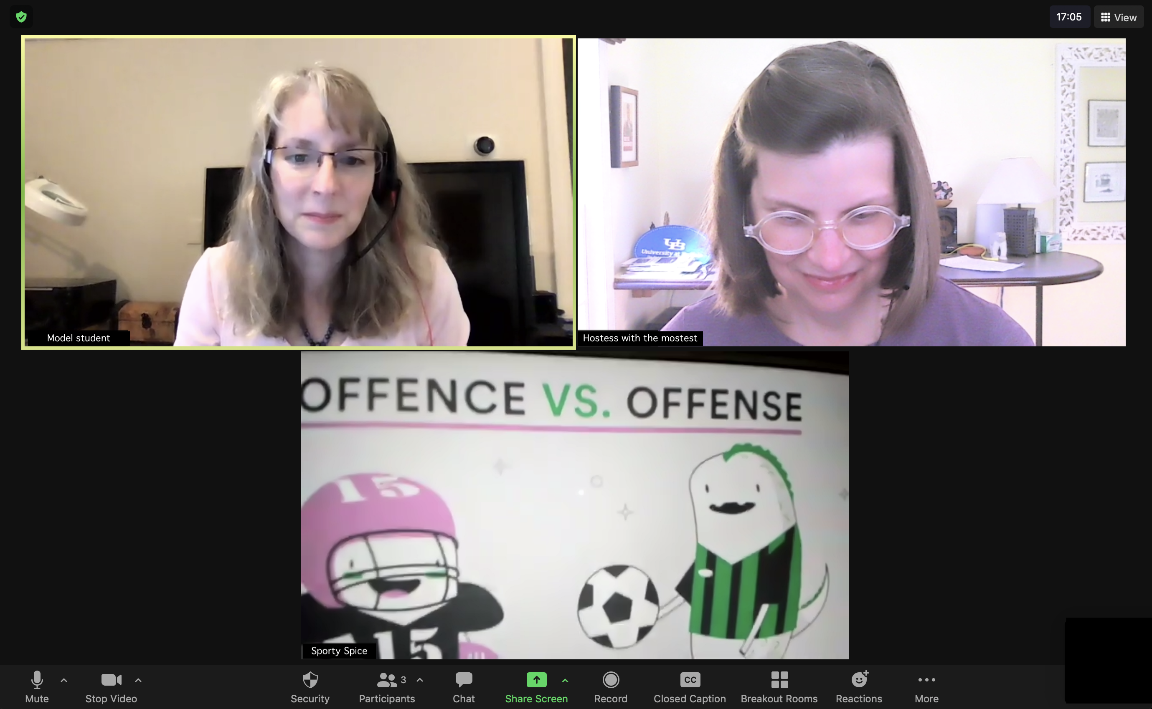
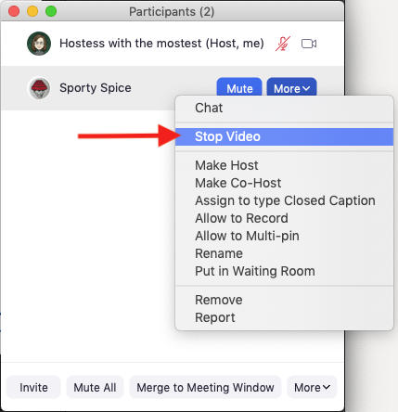
Webcam video
Turn off an individual’s video in the Participant panel
Notes:
Interlopers may do off-color or offensive things on camera, stop their video to remove that distraction.

Slide 12
Demo
Webcam video
Open the Participants panel
Hover over the participant’s name
Click More > Stop Video
Notes:
B&D: Be visually obnoxious on camera!

Slide 13
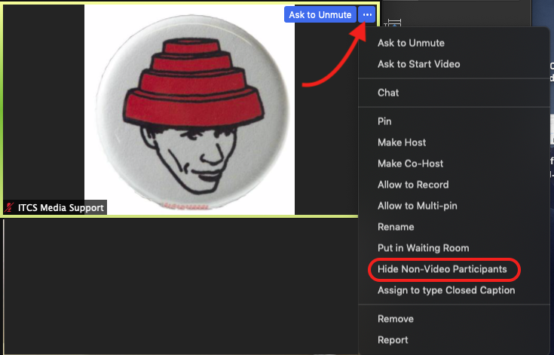
Profile Picture
Anyone who joined on a computer can Hide Non-Video Participants.
The host cannot force this view for all attendees.
Notes:
D&B: Time for that risqué profile pic!

Slide 14
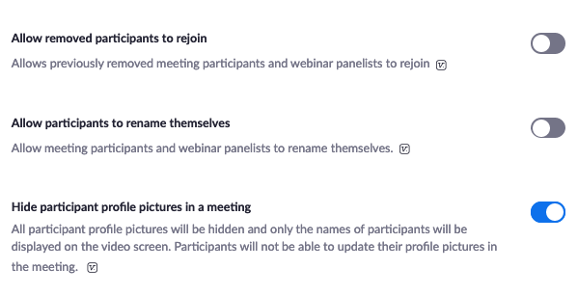
Profile Picture
If someone has an offensive profile picture you cannot undo that during the meeting.
Adjust your Zoom profile settings before scheduling a meeting. Turn on Hide participant profile pictures in a meeting
Notes:
B&D: Rename yourself is you haven’t already!

Slide 15
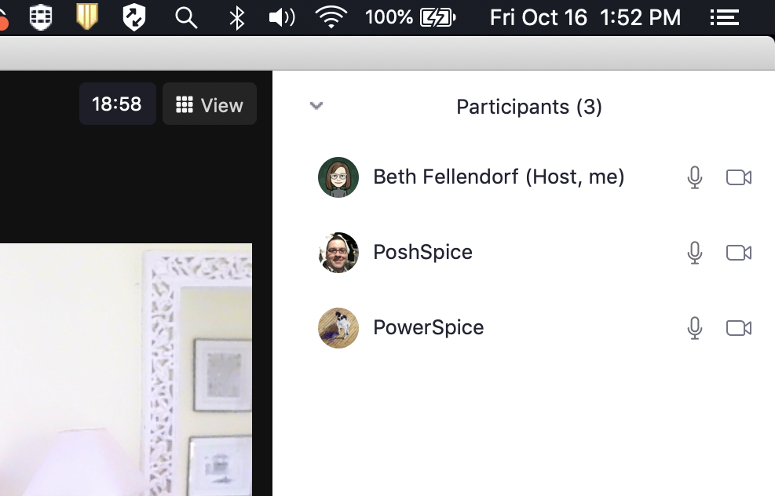
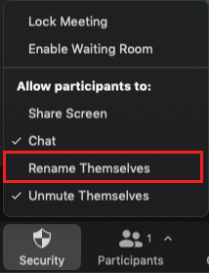
Inappropriate screen name
At the beginning of your meeting, open Security settings and uncheck Rename themselves.
Notes:
A host does have the power to rename any participant, however, you won’t want to do that with a large number of students.
So set this in your profile settings or uncheck “rename themselves” in the Security options as soon as you start the meeting.

Slide 16
Inappropriate screen name
Ensure no one can rename themselves in your meeting, adjust your Zoom profile settings and turn off Allow participants to rename themselves.
This does not prevent someone from updating their profile name to something objectionable.

Slide 17

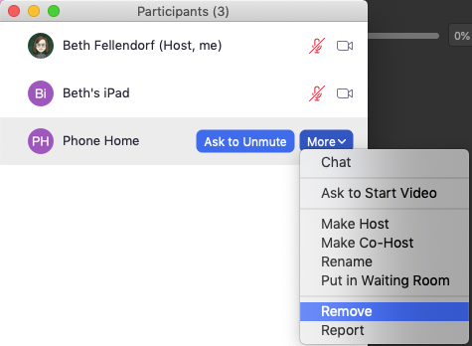
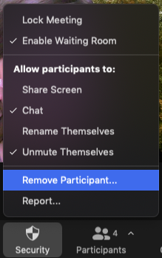
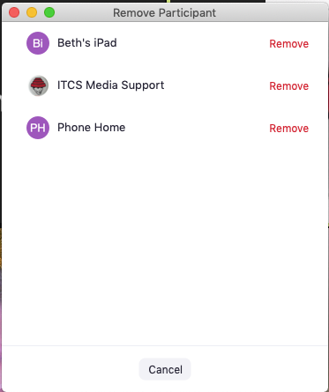
Remove a disruptive person
Participants panel
Security button

Slide 18
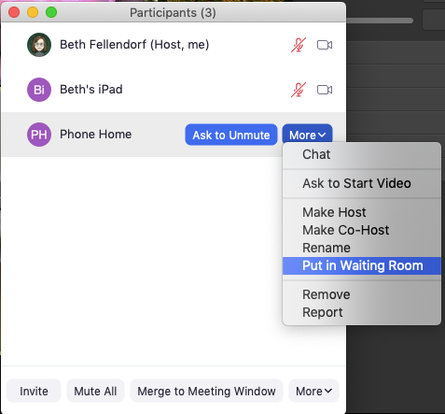
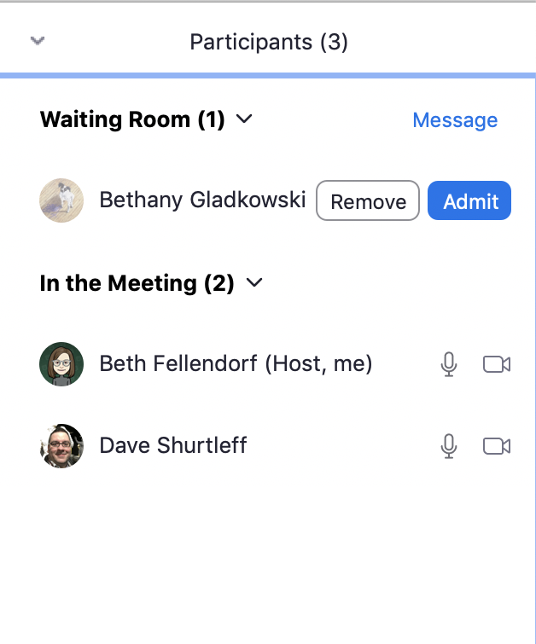
Remove a disruptive person
Participants panel – send to the Waiting Room
Notes:
The person in the waiting room can’t speak or be seen and is not able to see or hear the meeting.
You can remove someone from the waiting room.

Slide 19
Remove a disruptive person
If you remove someone you do not want them to be able to rejoin. Adjust your Zoom profile settings and turn off: Allow removed participants to rejoin.

Slide 20
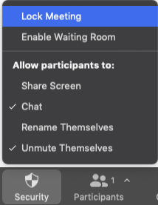
Lock your meeting
Locking your meeting prevents anyone, legitimate or not, from entering.
Do this after your meeting begins, or if you remove someone and there’s a possibility they could rejoin.
Click the Security button and choose Lock Meeting.

Slide 21
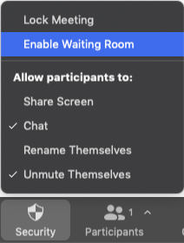
Enable the waiting room
Enable the Waiting Room at any time during your meeting. This allows you or a co-host to control the arrival of latecomers.
Click the Security button and choose Enable Waiting Room.
Placing a participant in the Waiting Room does not automatically enable the waiting room for other attendees.

Slide 22
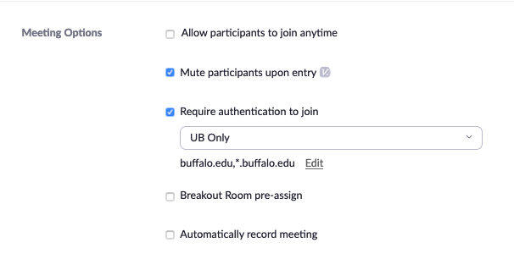
Require authentication to join
Require authentication to join / Only authenticated users can join
For classes in particular, enable Require authentication to join and choose UB Only (the default). This setting limits attendees to people who are signed into Zoom with a UBIT name and password.

Slide 23
Troublemakers and Annoyances
Address these potential annoyances by updating your profile settings before you schedule a meeting.
Request Remote Control
No one can take control of your computer without your permission, but the requests can be annoying and potentially disruptive
Virtual Backgrounds
There is the potential for virtual backgrounds to be offensive or distracting
Video Filters
These are tons of fun, but they may become distracting
Notes:
Send a few requests for remote control!
Use those filters!

Slide 24
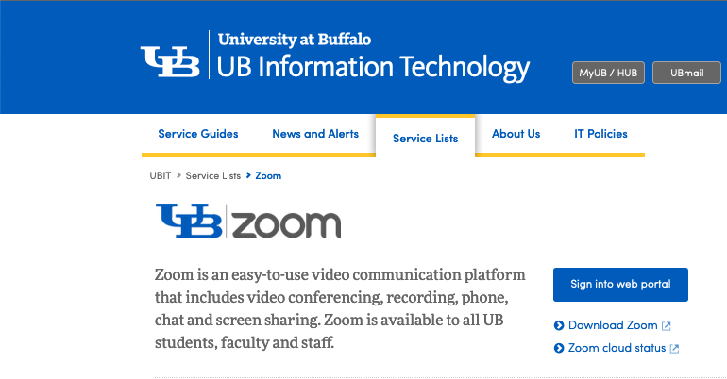
Zoom Profile Settings
Access your profile settings on the Zoom web portal (https://buffalo.zoom.us)
For information on how to configure your Zoom Profile settings see the downloadable guide from UBIT.
Notes:
You can also get to these setting through the Zoom desktop app, through Settings > View More Settings OR Profile > View Advanced Features

